Slide 1


Slide 2

Designing of IoT Solutions
INTRODUCTION
Notes:
Welcome to IoT

Slide 3
Disclaimer
This presentation is purely educational.
The views expressed by the presenter is not representation of any organization.
The views are based on professional experience of the presenter and no liability is accepted by the presenter in the event of any potential or perceived losses resulting from this presentation.

Slide 4
Raise your hand if you have any questions

Slide 5
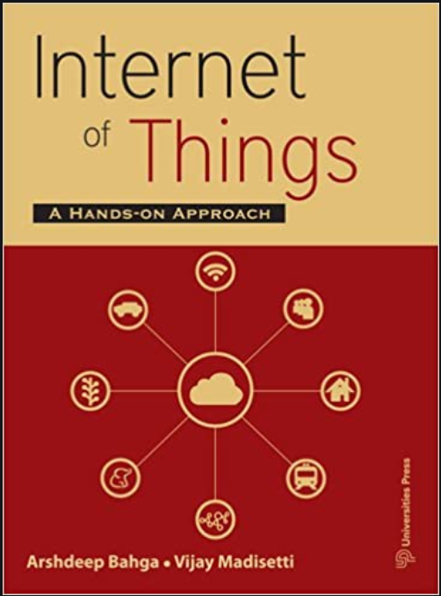
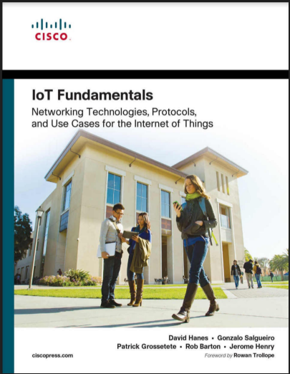
Know Your Course: Resources
Reference Books:
Arshdeep Bahga, Vijay Madisetti,
“Internet of Things – A hands-on approach”,
Universities Press, 2015
David Hanes
IoT Fundamentals | Networking Technologies,
Protocols, and Use Cases for the
Internet of Things
2017

Slide 6
Know Your Course: Syllabus
UNIT 1
Introduction to IoT
UNIT 2
Smart objects
and IoT Platforms Design Methodology
UNIT 3
IoT Physical Devices & Endpoints
UNIT 5
Case Studies and Advanced Topics
UNIT 4
IoT Physical Server and Data Analytics for IoT

Slide 7
Course Mechanics
Instructor: Prof. Charanraj B R
https://faculty.pes.edu/p10367
Classes:
Come to class! Not every bit of material will be on the slides or in the text.
Some classes will be Labs!

Slide 8
Course Mechanics
You will need to join my class on the Edmodo environment
https://Edmodo.com – (use this link to Join).
Class Code: fqnnfb
Submit all assignments online thru Edmodo using Office 365 or equivalent
Email submission NOT accepted

Slide 9
Course Mechanics
Feedback is encouraged!
Email me at brcharanraj@gmail.com or charanrajbr@pes.edu

Slide 10
Grading Scheme
Assessment policy: In Semester Assessment (ISA) Max : 60
Assessment policy: End Semester Assessment (ESA) Max: 40
Total = ISA + ESA = 100 marks
Activity | Marks | Remarks
ISA 1 | 20 | Scaled down to 9
ISA 2 | 20 | Scaled down to 6
Mini Project | 50 (approx.) | Scaled down to 10
Total Marks | 25
Activity | Marks | Remarks
Pen and Paper | 50 | Scaled down to 25
Total marks | 25

Slide 11
Grading
If any assignment, lab work is submitted late, the following applies:
Late by up to 24 hours ( 1 day) – lose 25% of your marks
Late by up to 48 hours (2 days) – lose 50% of your marks
Late by up to 72 hours (3 days) – lose 75% of your marks
Late Beyond 72 hours – Zero

Slide 12
Honour Code for UE18CS306A – Designing of IoT Solution
The Honour Code is the statement on academic integrity.
It articulates our expectations of students and faculty in establishing and maintaining the highest standards in academic work.

Slide 13
Academic Honesty
Academic honesty is expected from each student participating in the course.
No sharing (willing, unwilling, knowing, unknowing) of assignment code between students
No submission of downloaded code (from the Internet, Campus LAN, or anywhere else) is accepted

Slide 14
Plagiarism (adopted from Indiana University)
Plagiarism is defined as presenting someone else’s work, including the work of other students, as one’s own.
Any ideas or materials taken from another source for either written or oral use
must be fully acknowledged, unless the information is common knowledge.
What is considered “common knowledge” may differ from course to course.
A student must not adopt or reproduce ideas, opinions, theories, formulae, graphics, or pictures of another person without acknowledgment.

Slide 15
Plagiarism (adopted from Indiana University)
For those NOT familiar, please visit the links and follow the instructions.
https://www.indiana.edu/~tedfrick/plagiarism/index2.html
https://www.indiana.edu/~academy/firstPrinciples/
Any plagiarism will result in Zero marks for the assignment/work
And in addition, downgrade of final subject result by ONE grade!
For both students giving and students taking e.g. B to C, D to E

Slide 16
Centre for Internet of Things

Slide 17
Research Team of C-IoT
Prof. Prasad H.B. – Director
Prof. Charanraj B. R.
Prof. Sunitha R.
Prof. Revathi G. P.
Prof. Rajashree S.
Prof. Samatha R Swamy
Prof. Pushpa G
Prof. Rachana B S

Slide 18
Objectives of C-IoT
Provide students and faculty opportunities to work on IoT domains.
Address the security of IoT platforms comprehensively working with Centre for Information Security (ISFCR).
Form a research and development community with cross disciplinary collaboration.
Pursue research in IoT technology, applications and services.

Slide 19
Domains of C-IoT

Slide 20
1. Industrial IoT
Industry 4.0,
SCADA,
Autonomous Vehicles,
Robotics,
Drones and appliances

Slide 21
2. Smart City
Traffic Management
Smart Parking
Green and Smart Buildings
Real Time Updates
Home Automation
City Wide wifi connectivity
Waste Management
Water, Air and Noise Pollution
Ease of Living
Sustainabllity
Reuse and renew
E-waste, Solid, Bio

Slide 22
3. Critical Information Infrastructure (CII)
The focus here is to protect CII from cyber attacks and Denial of Service attacks.
This includes all forms of transport
Generation and distribution of Energy
Potable Water supply and distribution
Financial services including Banking, Digital payments etc.

Slide 23
4. Rural IoT
Water Management
Pest management
Live stock management
Rural Iot
Smart dairy
Smart agriculture
Smart Waste management

Slide 24





5. Medical IoT
Research
Patient Care information
Emergency care
Medical Information distribution
Devices

Slide 25
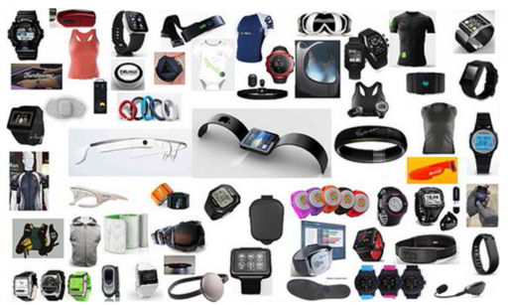
6. Wearable's

Slide 26
Technical Strategy - Template
Source: Gartner (December 2017)

Slide 27
Planned Activities

Slide 28
1. Teaching / Learning (1/2)
Curate and offer both a 2 credit and 4 credit course in IoT.
Encourage students to make/ build
Students will learn from Hands-on experience

Slide 29
1. Teaching / Learning (2/2)
Focus on Security, privacy and Data localization
Perform penetration testing
Forensics and Resilience

Slide 30
2. Industry Engagement
As we build our internal/inhouse capability and competency, we should be able to partner with Industry and work on real life problems.
We intend to consult with Industry.

Slide 31
3. Research
With a focus on research, we intend to first understand the current state of the domain and thereafter push the boundaries.
We will share our work done by publishing in Conference and Journals.
A first paper was presented recently at International Conference on Sustainable Communication Network and Application [ICSCN 2019]. This is Scopus Indexed.

Slide 32
4. Executive Education & Training
PES Alumni,
Non-PES students and
Working Professionals.

Slide 33
Current Status
A few projects are in progress
Smart Irrigation system
Obstacle avoiding Robots
Multifunctional Robots

Slide 34

Funding Organization
The Centre is NOW fully FUNDED by PES University

Slide 35
Location
PES University,
B-Block, 11th floor, Room No. 1112
RR Campus,
Bangalore
Contact: Prof. Charanraj B R
Email:charanrajbr@pes.edu

Slide 36
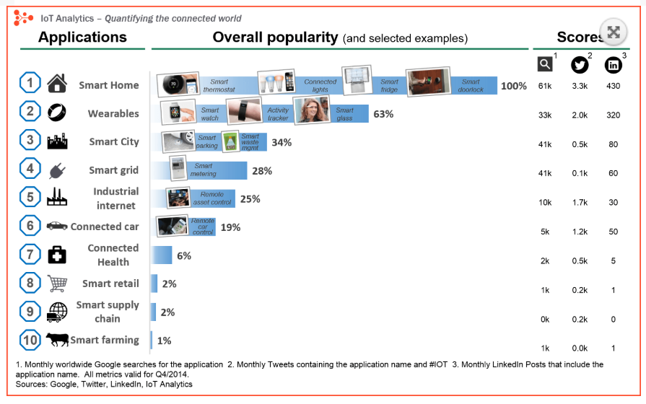
Application of IoT

Slide 37

Charanraj B R
Computer Science and Engineering
PES University, Bengaluru
THANK YOU

